Slide 1

Regular expressions

Slide 2
Plan
What is regex and where it’s used
Syntax
Java examples
QA

Slide 3
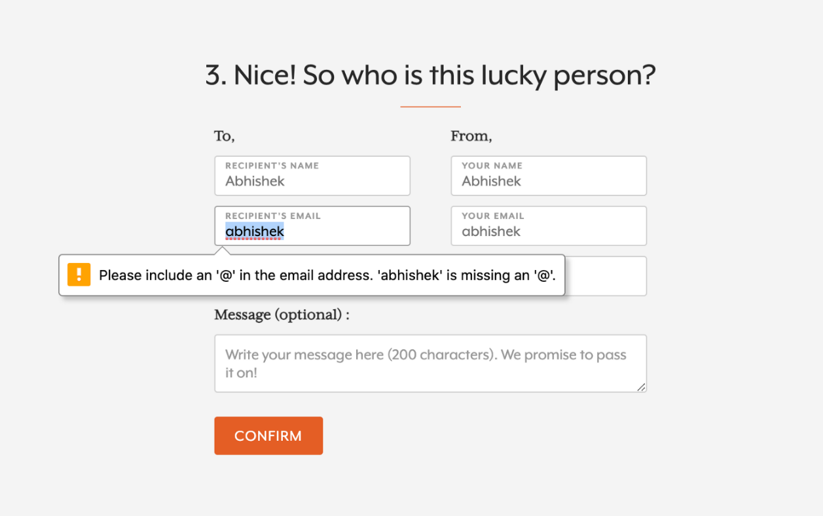
Regex
A regular expression is a sequence of characters that forms a search pattern.
Example: Email validation
^[\w-\.]+@([\w-]+\.)+[\w-]{2,4}$
Price check
/(\$[0-9,]+(\.[0-9]{2})?)/
The name of user in twitter
/@([A-Za-z0-9_]{1,15})/

Slide 4
Syntax
Anchors — ^ and $
^ - Finds a match as the beginning of a string
Example: ^The matches any string that starts with The (The car, The end,…)
[^c]ar => The car parked in the garage.
$ - Finds a match at the end of the string
Example: end$ matches a string that ends with end (happy end, The end,…)
Example: end matches a string that has end (happy end, The end is near,…)
Character classes — \d \w \s and .
\d - Find a digit ([0-9]) \D - Find a NON digit [^\d]
\s - Find a whitespace character ([\t\n\f\r\p{Z}]) \S - Find a NON whitespace character [^\s]
\w - Find a word character ([a-zA-Z0-9_]) \W - Find a NON word character ([^\w])
. - Find just one instance of any character
Example: .ar => The car parked in the garage.
ar[.] => A garage is a good place to park a car.

Slide 5
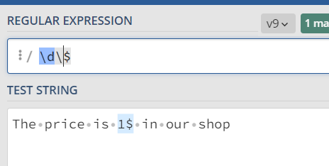
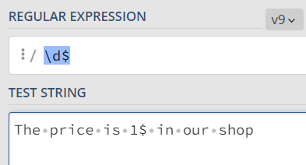

Syntax
\ - In order to be taken literally, you must escape the characters ^.[$()|*+?{\ with a backslash \ as they have special meaning
Example: \d\$ - matches a string that has a digit followed by $
\d$ - matches a string that has a digit at the end
In Java we should use \\

Slide 6
Syntax
OR operator — | or []
[abc] Find one character from the options between the brackets
[^abc] Find one character NOT between the brackets
[0-9] Find one character from the range 0 to 9
| - Find a match for any one of the patterns separated by |
Example: I like (java|css) matches a string that has “I like ”followed by java or css
I like java /I like css
I like java|css matches a string that has I like java or css
I like java / css
Do not forget about ()

Slide 7
Quantifiers * + and ?
* - Matches any string that contains zero or more occurrences of symbols before it
Example: abc* matches a string that has ab followed by zero or more c
(ab, abc, abcc,…)
a(bc)* matches a string that has a followed by zero or more copies of the sequence bc
(a, abc, abcbc,…)
+ - Matches any string that contains at least one n symbols before it
Example: abc+ matches a string that has ab followed by one or more c
(abc, abcc,…)
? - Matches any string that contains zero or one occurrences of symbols before it
Example: abc? matches a string that has ab followed by zero or one c
(ab, abc)

Slide 8
Quantifier {}
{x} - Matches any string that contains a sequence of X symbols before it
Example: abc{2} matches a string that has ab followed by 2 c
(abcc)
{x,y} - Matches any string that contains a sequence of X to Y symbols before it
Example: abc{2,4} matches a string that has ab followed by 2 up to 5 c
(abcc, abccc, abcccc)
a(bc){2,3} matches a string that has a followed by 2 up to 5 copies of the sequence bc
(abcbc, abcbcbc)
n{x,} - Matches any string that contains a sequence of at least X symbols before it
Example: abc{2,} matches a string that has ab followed by 2 or more c

Slide 9
Regex in Java
Pattern Class - Defines a pattern (to be used in a search)
Method | Description
static Pattern compile(String regex) | compiles the given regex and returns the instance of the Pattern.
Matcher matcher(CharSequence input) | creates a matcher that matches the given input with the pattern.
int flags() | Returns this pattern's match flags.
String[] split(CharSequence input) String[] split(CharSequence input, int limit) Stream<String> splitAsStream​ (CharSequence input) | splits the given input string around matches of given pattern.
Predicate<String> asPredicate() | Creates a predicate which can be used to match a string.

Slide 10
Regex in Java
Matcher Class - Used to search for the pattern
PatternSyntaxException Class - Indicates syntax error in a regular expression pattern
Method | Description
String pattern() | returns the regex pattern.
static boolean matches(String regex, CharSequence input) | It works as the combination of compile and matcher methods. It compiles the regular expression and matches the given input with the pattern. (implicitly add a ^ at the start and $ at the end of your pattern, meaning it will not look for a substring)
boolean find() | Attempts to find the next subsequence of the input sequence that matches the pattern.
int start | returns the start index of the previous match
int end | returns the offset after the last character matched.
String group | returns the input subsequence matched by the previous match
String replaceAll | Replaces every subsequence of the input sequence that matches the pattern with the given replacement string.

Slide 11
Regex in Java
Demo time

Slide 12
Useful links
https://regex101.com/
https://cheatography.com/davechild/cheat-sheets/regular-expressions/
https://www.hongkiat.com/blog/regex-web-developers/

Slide 13
QA
Do you have any questions?

